Slide 1

LABOUR SAFETY ANALYSIS USING OBJECT DETECTION AND DEEP LEARNING
Under the guidance of
Ms.D.Evangeline
Assistant Professor
Dept of ISE
RIT
Submitted by JATIN B – 1MS20IS054
MANOJ S – 1MS20IS070
PANNAGA N - 1MS20IS083
SANJEEV G - 1MS21IS406 Dept of Information Science & Engineering
Mini Project - ISE

Slide 2
LABOUR SAFETY ANALYSIS USING OBJECT DETECTION AND DEEP LEARNING

Slide 3
Index
Motivation
Problem statement
Literature survey
Objective
Methodology
Implementation
Summary And Future Work

Slide 4
Overview

Slide 5
Motivation
Construction sites are dangerous.
Workers are required to wear various types of safety equipment, such as hard hats, safety glasses, and safety vests, to protect themselves from hazards.
Manual inspection is often time-consuming and prone to errors.
Computer Vision and Deep Learning has potential for constant monitoring.
Improve safety in the workplace.
Reduce the risk of accidents and injuries on construction sites.

Slide 6
Problem Statement
Despite advancements in industrial sector, occupational accidents remain a significant concern in many industries.
Traditional safety monitoring systems often rely on manual inspection which are prone to errors, delays and inconsistencies.
There is a need for a more reliable, efficient and objective approach to monitor workplace safety and identify potential hazards.
To develop an automated labour safety analysis system that can detect potential hazards and improve workplace safety.

Slide 7
Objective
-To identify people in the frame.
-To perform object recognition of masks, helmet and vest.
-To classify people who aren’t wearing the above-mentioned safety equipments.

Slide 8
LITERATURE SURVEY
Sl. No | Paper Title, Author, Year of Publication | Abstract , Technique mentioned | Limitations
1. | Pestana, D., Miranda, P. R., Lopes, J. D., Duarte, R. P., Véstias, M. P., Neto, H. C., & De Sousa, J. T. (2021). A full featured configurable accelerator for object detection with YOLO. IEEE Access, 9, 75864-75877. | To present a configurable accelerator for object detection using the YOLO algorithm. Involves designing and implementing a configurable hardware accelerator for the YOLO object detection algorithm using a field-programmable gate array (FPGA). | Does not provide a detailed analysis of the cost and power consumption of the proposed accelerator.

Slide 9
2. | Zeng, L., Duan, X., Pan, Y., & Deng, M. (2022). Research on the algorithm of helmet-wearing detection based on the optimized yolo v4. The Visual Computer, 1-11. | To develop an algorithm for helmet-wearing detection using the optimized YOLOv4 algorithm. To address the challenges in helmet detection, such as low accuracy and slow processing times. Involves developing a helmet-wearing detection algorithm based on the YOLOv4 object detection framework. | The dataset used in the evaluation is relatively small and may not represent real-world scenarios accurately.
3. | Nath, N. D., Behzadan, A. H., & Paal, S. G. (2020). Deep learning for site safety: Real-time detection of personal protective equipment. Automation in Construction, 112, 103085. | The authors aim to address the challenges in PPE detection, such as the need for manual inspection and the potential for human error, by proposing an automated system that can detect PPE in real-time. The authors used a convolutional neural network (CNN) to detect PPE items, including hard hats, safety vests, and boots, in images and videos captured by on-site camera | The evaluation of the system is based on a limited dataset and may not represent real-world scenarios accurately.

Slide 10
4. | Tang, S., Roberts, D., & Golparvar-Fard, M. (2020). Human-object interaction recognition for automatic construction site safety inspection. Automation in Construction, 120, 103356. | To improve safety compliance checking using computer vision object detection methods To explicitly classify worker-tool interactions to enable more accurate compliance checks The authors used deep learning techniques, including CNNs and recurrent neural networks (RNNs), to recognize various human-object interaction (HOI). | The precision and recall rates achieved by the proposed model may still not be sufficient for real-world deployment and may require further refinement and optimization.
5. | Chen, Z., Zhang, F., Liu, H., Wang, L., Zhang, Q., & Guo, L. (2023). Real-time detection algorithm of helmet and reflective vest based on improved YOLOv5. Journal of Real-Time Image Processing, 20(1), 4. | To develop a real-time detection algorithm and To improve the accuracy for helmets and reflective vests using YOLOv5. To enable real-time monitoring of PPE compliance in large-scale operations. Train YOLOv5 model for object detection framework Optimize the YOLOv5 model to improve its accuracy and speed for detecting helmets and safety vest. | The proposed algorithm may not work well when helmets or reflective vests are obscured or worn improperly. The real-time monitoring of compliance may require additional infrastructure and may not be feasible.

Slide 11
6. | Zhao, B., Lan, H., Niu, Z., Zhu, H., Qian, T., & Tang, W. (2021). Detection and Location of Safety Protective Wear in Power Substation Operation Using Wear-Enhanced YOLOv3 Algorithm. IEEE Access, 9, 125540-125549. | Develop a deep learning-based system that can detect and locate safety protective wear.The proposed system is based on the YOLOv3 algorithm, YOLOv3 algorithm is trained on a dataset of images of personnel wearing safety protective gear in power substations. | System relies on the availability of high-quality images of safety gear.System may not be able to detect safety protective gear that is partially covered or obscured.
7. | Balakreshnan, B., Richards, G., Nanda, G., Mao, H., Athinarayanan, R., & Zaccaria, J. (2020). PPE compliance detection using artificial intelligence in learning factories. Procedia Manufacturing, 45, 277-282. | To develop a system for detecting PPE compliance using artificial intelligence in learning factories. The system used wearable sensors and cameras to capture real-time data on worker behavior and PPE usage, which was processed using ML and computer vision algorithms to detect violations of PPE regulations. | It relies on workers wearing the required PPE and using it correctly. The system's effectiveness may be limited by the accuracy of the sensors and cameras used to capture data on worker behavior and PPE usage.

Slide 12
8. | Shrestha, K., Shrestha, P. P., Bajracharya, D., & Yfantis, E. A. (2015). Hard-hat detection for construction safety visualization. Journal of Construction Engineering, 2015(1), 1-8. | To develop a computer vision-based system for detecting hard hats in construction sites to enhance worker safety. To provide real-time monitoring and alert managers and supervisors to potential safety violations. The system used image processing algorithms to identify workers wearing hard hats and distinguish them from workers without hard hats. | It assumes that all workers on the construction site should wear hard hats. The environmental factors such as poor lighting or obstructed views may affect the accuracy of the system's image processing algorithms.

Slide 13
methodology
Flowchart
Schema Diagram
Algorithms
Comparison of methods
Mediapipe

Slide 14
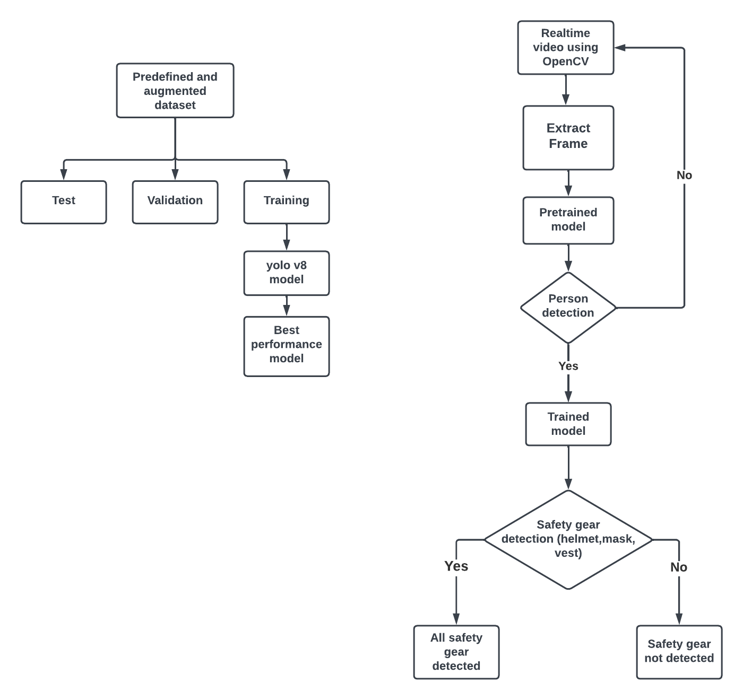
Flowchart

Slide 15
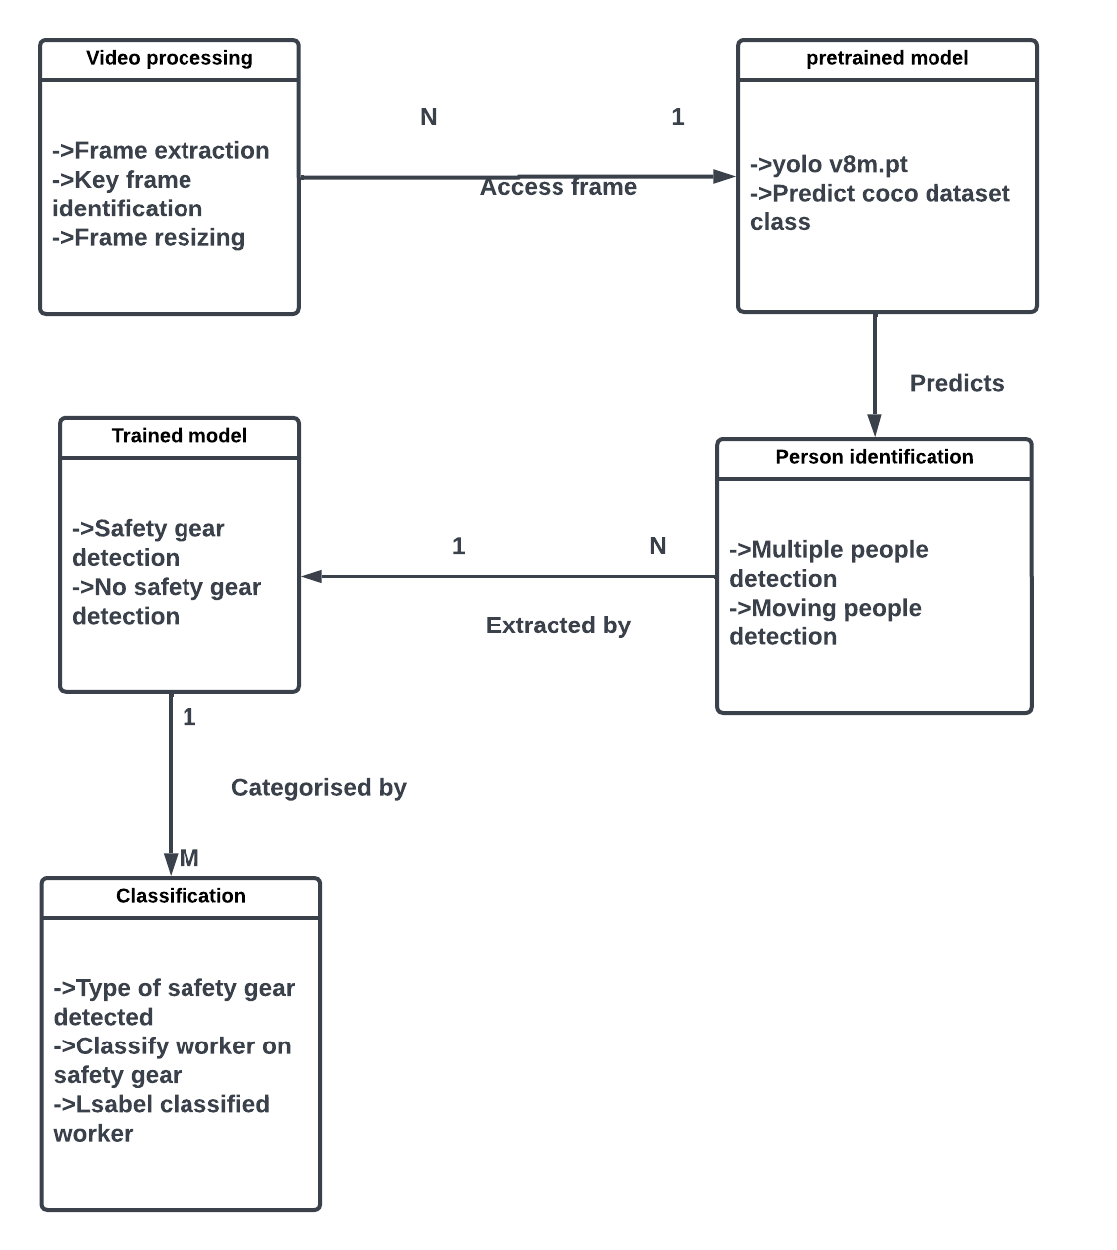
Schema Diagram

Slide 16
Algorithm: Input and Output
Inputs:
frame: input image to be analyzed.
Outputs:
modified frame with safety gear detection.
Notes:
Define a function named 'find_safety_gear' that takes a frame as input
Use the YOLO model to make predictions on the input frame and get the bounding box coordinates
Extract the bounding box coordinates, confidence score and class ID for each detected object
Check if the confidence score is greater than threshold and the class ID is equal to 5 (person)
If yes, draw a rectangle around the detected object and crop the frame to the region of interest (ROI) containing the worker
Make predictions on the ROI using the YOLO model and get the bounding box coordinates for the safety gear worn by the worker
Extract the bounding box coordinates, confidence score and class ID for each detected safety gear
Check if the confidence score is greater than 0.5 and the class ID is either 0 (helmet), 3 (mask) or 7 (vest)

Slide 17
Algorithm: Steps
Training YOLO v8 model with augmented dataset.
Applying the trained YOLO model on each frame of a video.
Drawing a green rectangle around detected people:
Key frame extraction techniques: These techniques analyze the differences in content, motion, or other visual features between consecutive frames.
Safety gear detection based on key frames.
Positive or negative response and alert message.
Note: The threshold values for confidence score and the color and label assignment can be adjusted based on the specific use case.
Notes:
If yes, set the corresponding flag for safety gear as True
Based on the combination of flags, assign a label and color to the detected worker
Draw the label on the detected worker's bounding box
Return the modified frame
Load an image using cv2.imread() and resize it to a fixed size
Call the 'find_safety_gear' function on the input image and display the result using cv2.imshow()
Wait for user input using cv2.waitKey() and then destroy all windows using cv2.destroyAllWindows()

Slide 18
Methodology
Approach of Key frame extraction to avoid data redundancy and computation
1. Worker frame caching method
Creates a worker_results_cache dictionary to store the results of predict() for each worker frame.
On encountering worker call predict() and store the results in the cache using a key that includes the coordinates of the worker frame.
If same worker frame detected values taken from cache instead of predict

Slide 19
2. Periodic Approach
Instead of extracting every single frame from a video
Only a subset of the frames are extracted at a specific interval or rate

Slide 20
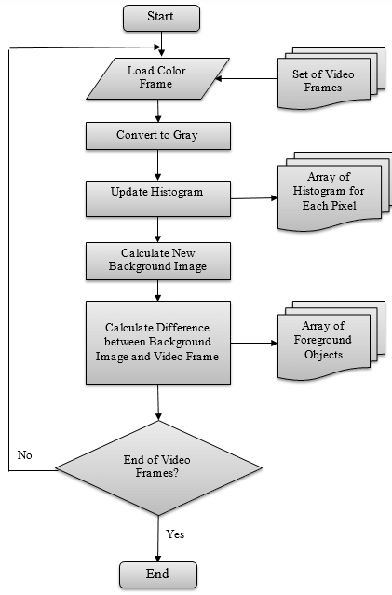
3. Boundary Subtraction
Helps to identify significant changes in the video frames
Using boundary subtraction, we can compare each frame to its neighboring frames
Identify the frames that contain significant changes
If changes are significant, then only predict

Slide 21
Comparison of Methodology
Method | Advantage | Disadvantage
Worker frame caching method | Useful for detecting movements in videos | Not suitable for detecting non-stationary objects or fast-moving objects
Boundary subtractor | Improves efficiency by reducing the need for reprocessing frames | Not suitable for videos with high variability or fast-changing scenes due to high memory requirements
Periodic Approach | Reduces the number of frames that need to be processed | May result in missed detections if key frames are skipped. Optimal value for n may vary depending on the video and object being detected.
Notes:
The boundary subtractor method is useful for detecting movements in videos
This method may not be suitable for detecting objects that remain stationary or objects that move slowly.
Caching method help improve the efficiency of object detection by reducing the number of times frames need to be reprocessed
Not suitable for videos with high variability or fast-changing scenes, as it may require a large amount of memory to store all the frames
The periodic approach involves processing every nth frame to reduce the number of frames that need to be processed, help improve the efficiency of object detection.
May also result in missed detections if key frames are skipped. Additionally, the optimal value for n may vary depending on the video and the object being detected.

Slide 22
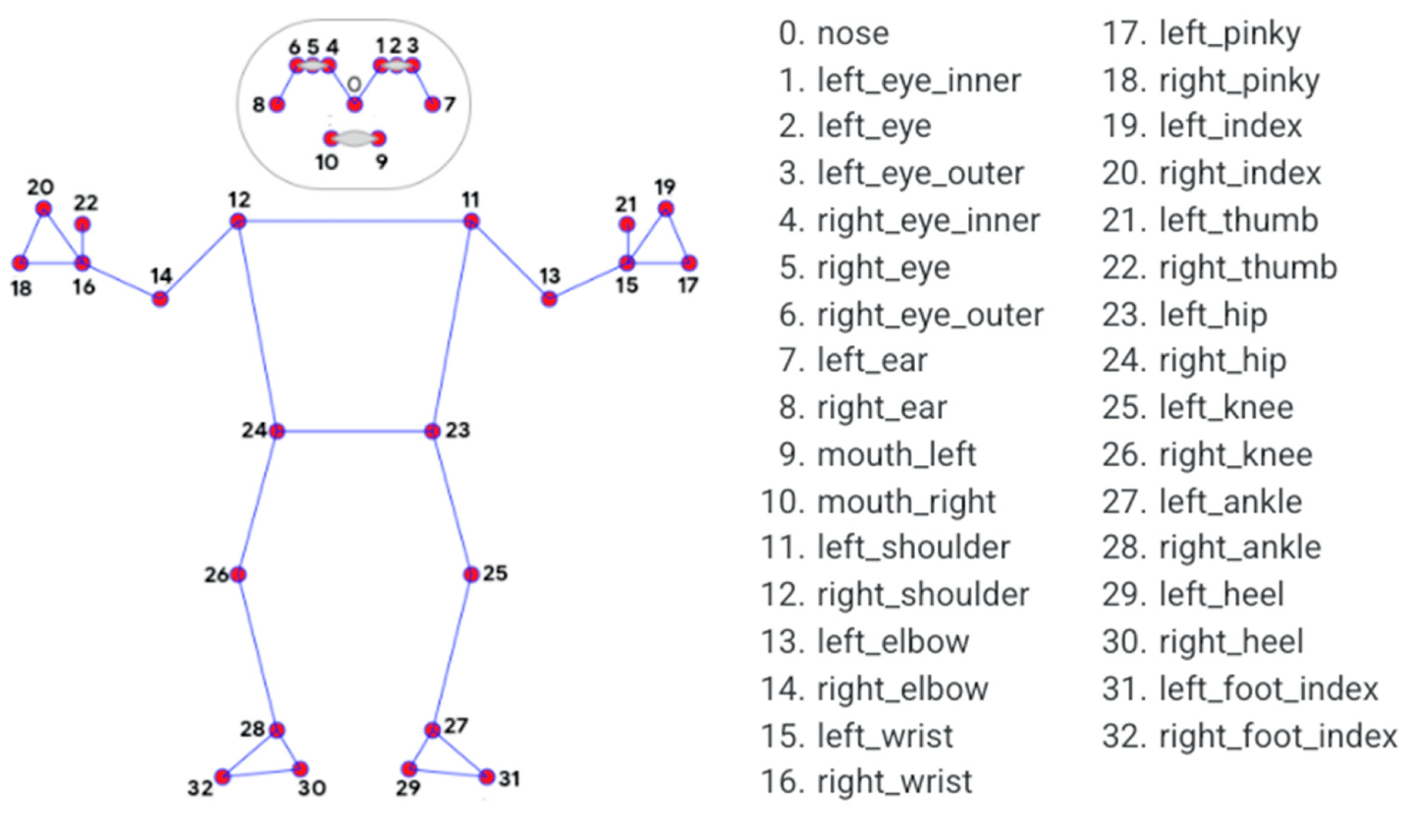
For enhanced Detection: Mediapipe
Mediapipe provides a pre-built model for human pose estimation
In the context of labor safety analysis, this model can be used in conjunction with object detection models to detect and track both workers and safety equipment in a video stream as given in .
For example, it can be used to detect when workers are not wearing proper safety equipment, such as helmets or safety harnesses, and when equipment is not being used correctly, such as when a forklift is being operated without proper safety guards.

Slide 23
Technique to measure Efficiency of approach
Measure efficiency by calculating average time per frame using time module.
Divide loop execution time by frames processed.
Print result to console.
Compare with previous approach to determine efficiency improvement.
Metrics : Average Time take to process each frame
Notes:
One way to measure the efficiency of this approach is to calculate the average time taken per frame to process. You can use the time module to measure the time taken for the execution of the loop and then divide it by the number of frames processed
This will print the average time taken per frame to the console. You can also compare this time with the time taken by the previous approach to see if there is any improvement in efficiency.

Slide 24
Design and Implementation
Dataset description
Hardware and Software
Tools and Techniques used for Implementation
Code
Implementation demo

Slide 25

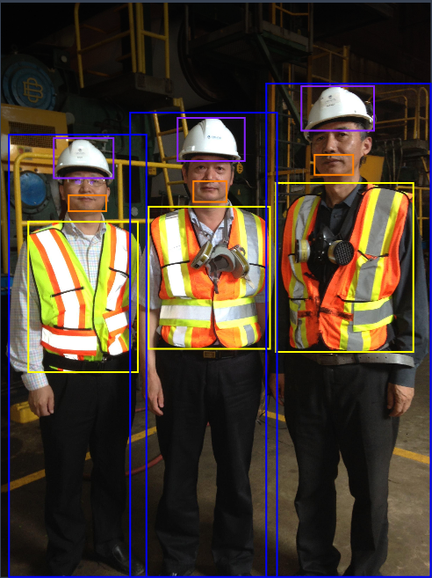
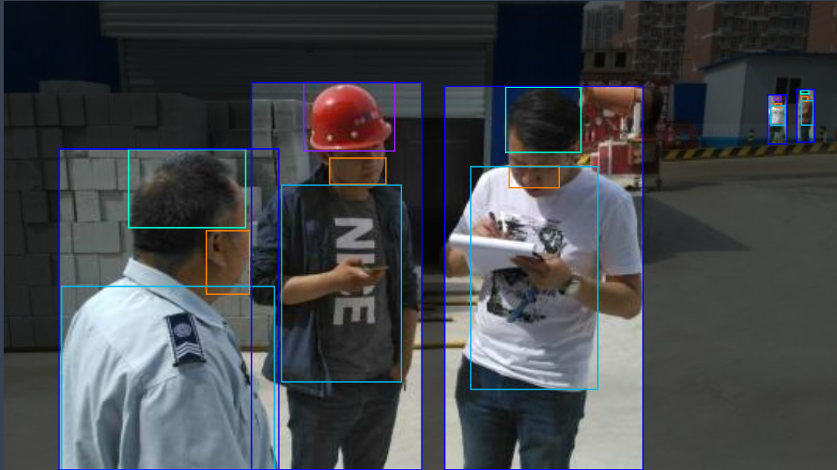
Dataset description
Title = Construction Site Safety Dataset
Type = Open Source Dataset
Author = Roboflow Universe Projects
Reference=https://universe.roboflow.com/roboflow-universe-projects/construction-site-safety/dataset/287

Slide 26
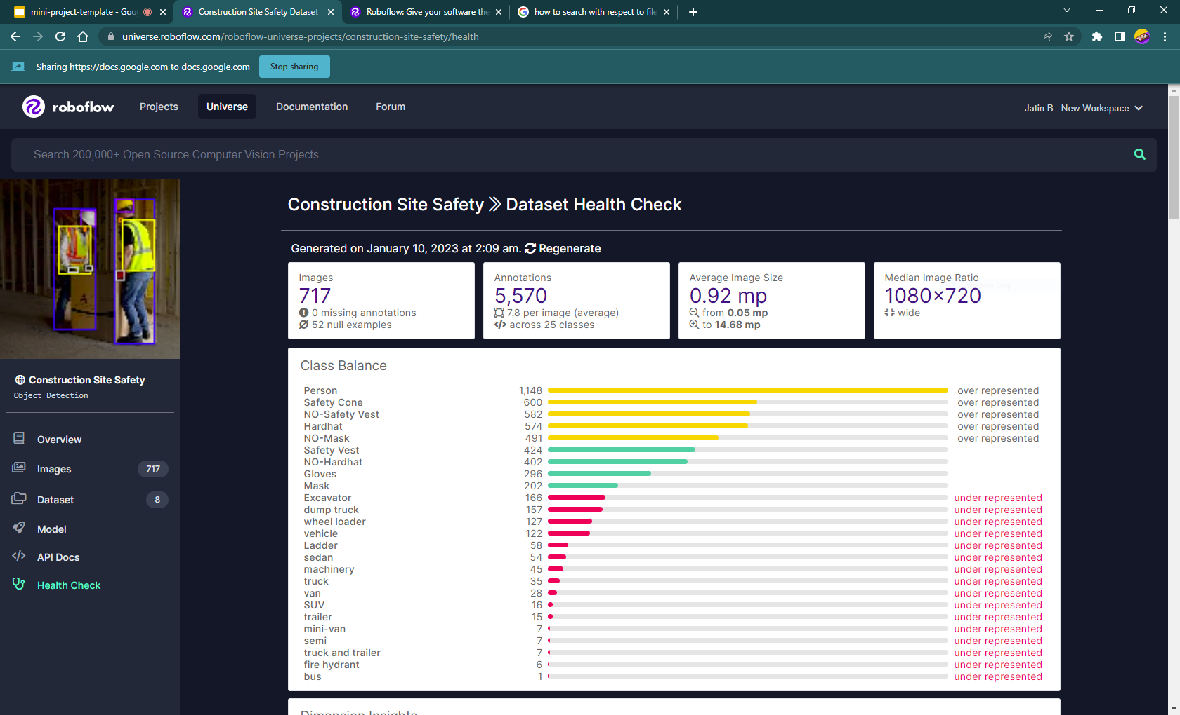
Dataset description (continued)

Slide 27
HARDWARE(Training and Running model)
CPU: Intel Core i7 or higher
GPU: NVIDIA GeForce RTX 2080 or higher (or equivalent AMD GPU)
RAM: 16GB or higher
Storage: 500GB of free storage
SOFTWARE
Python 3.6 or higher
PyTorch 1.7 or higher
CUDA Toolkit 10.1 or higher (for GPU acceleration)
Thonny IDE
OpenCV
Notes:
The NVIDIA® CUDA® Toolkit provides a development environment for creating high performance GPU-accelerated applications. With the CUDA Toolkit, you can develop, optimize, and deploy your applications on GPU-accelerated embedded systems, desktop workstations, enterprise data centers, cloud-based platforms and HPC supercomputers. The toolkit includes GPU-accelerated libraries, debugging and optimization tools, a C/C++ compiler, and a runtime library to deploy your application. Thonny is an integrated development environment for Python that is designed for beginners
For model deployment
OpenCV is a library of programming functions mainly for real-time computer vision.

Slide 28
Tools and techniques for implementation
Tools:
YOLOv8
Open CV
PyTorch
Techniques:
Preprocessing and Augmentation of Datasets
Training using CLI
Annotations
Key frame extraction
Frame cropping
Notes:
YOLO (“You only look once”) is an open-source image analysis AI system developed by the computer vision community since 2015.
OpenCV (Open Source Computer Vision Library) is an open source computer vision and machine learning software library. OpenCV was built to provide a common infrastructure for computer vision applications and to accelerate the use of machine perception in the commercial products.
PyTorch is a fully featured framework for building deep learning models, which is a type of machine learning that's commonly used in applications like image recognition and language processing. Written in Python, it's relatively easy for most machine learning developers to learn and use

Slide 29
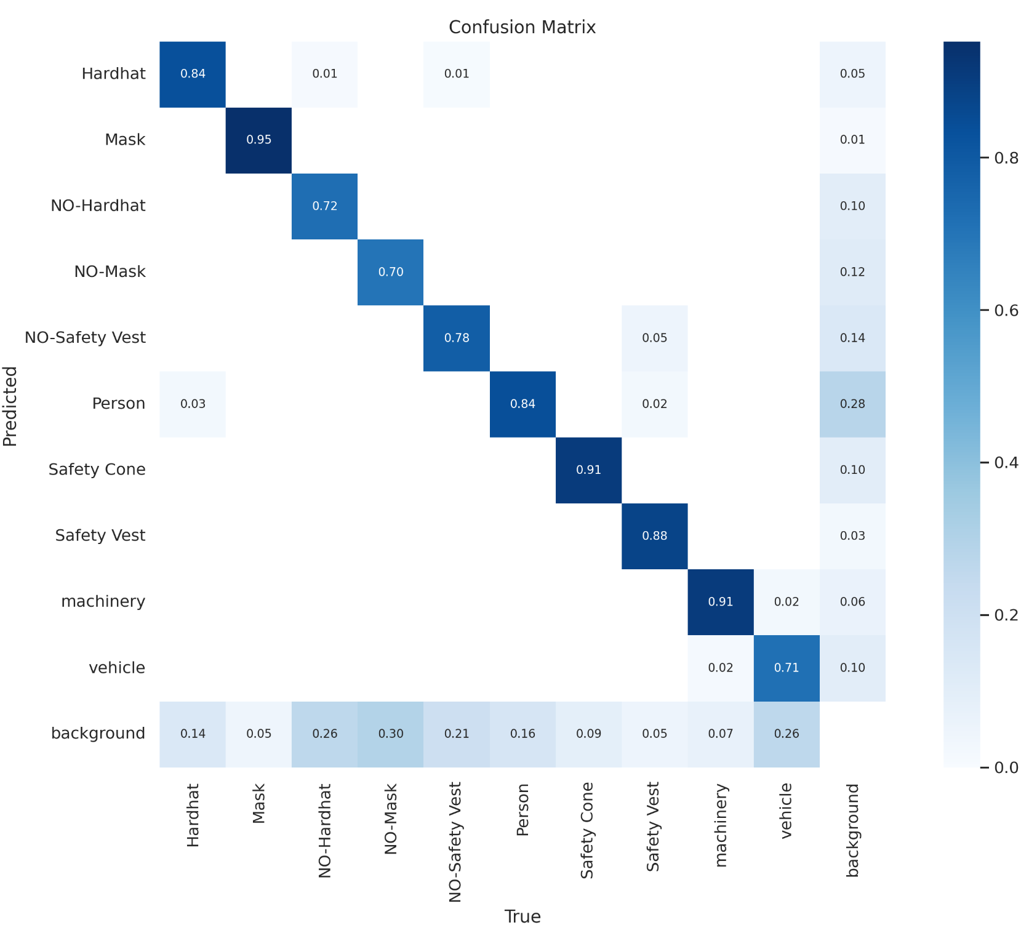
Model Performance
.
Notes:
Another way to define an epoch is the number of passes a training dataset takes around an algorithm

Slide 30
Code And Implementation

Slide 31
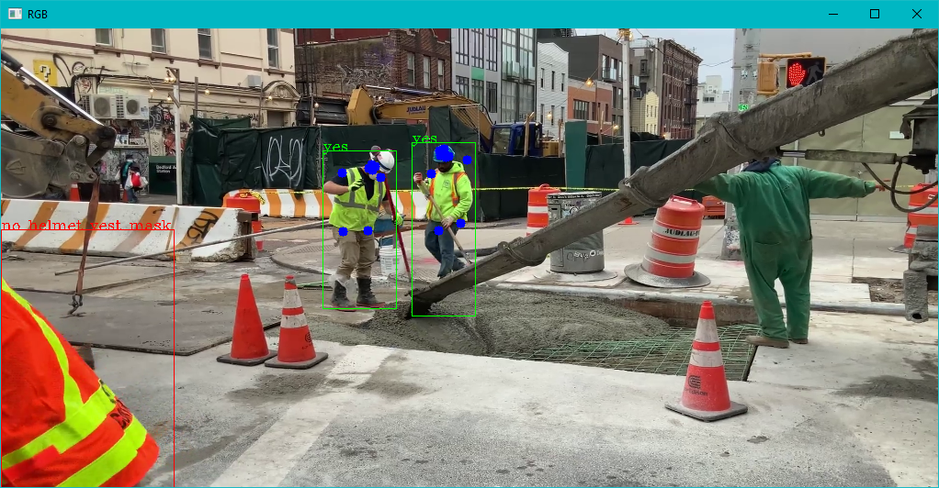
Mediapipe

Slide 32
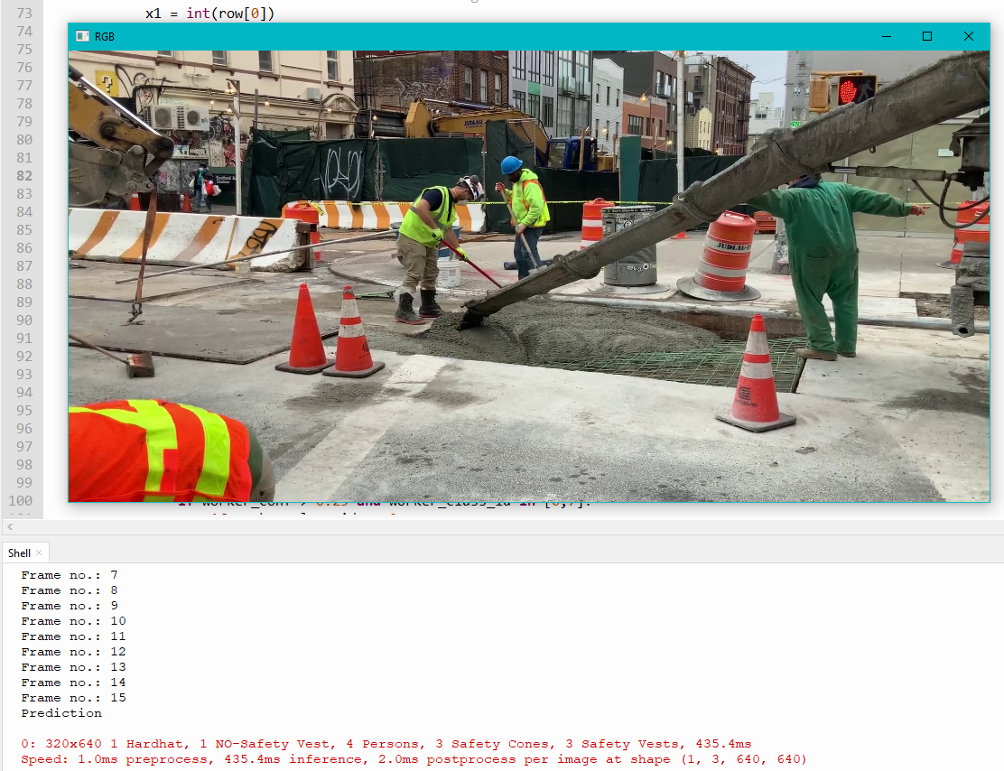
Periodic Approach

Slide 33
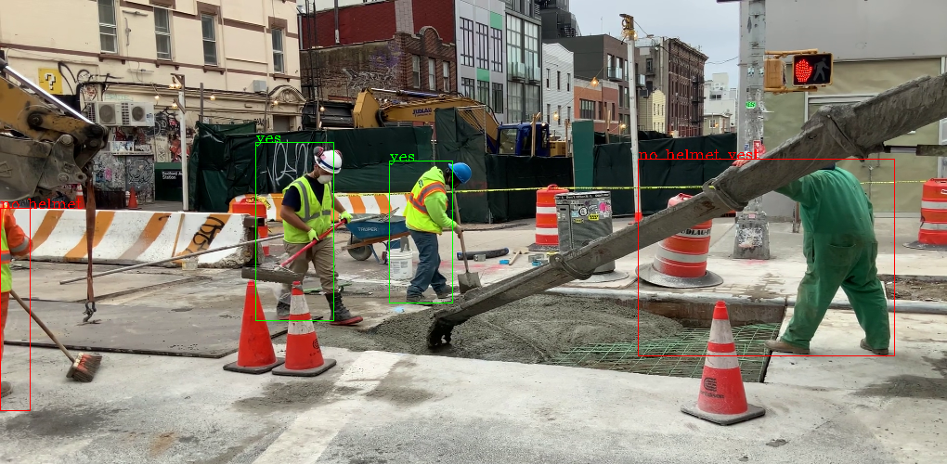
Caching

Slide 34
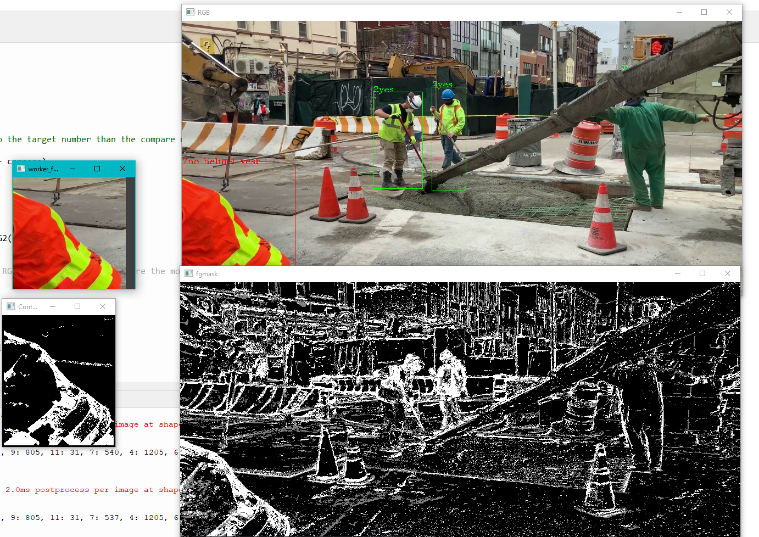
Background Subtraction

Slide 35
Summary & Future Work
Summary:
It has been possible to detect whether necessary safety gear is being worn by workers in a video using the YOLO object detection model.
Applied 3 different approaches for Key frame extraction
Measured the efficiency of the each method while running on a video frame.
Future Works:
Optimizing the detection model and dataset
Explore different ways to visualize the safety gear detection results
Explore more complex safety gear detection tasks
Explore different feature
Generalization(Able to apply to other fields)
Notes:
detecting whether the safety gear is being worn correctly or detecting safety hazards in the workplace.

Slide 36
References
[1] D. Pestana et al., "A Full Featured Configurable Accelerator for Object Detection With YOLO," in IEEE Access, vol. 9, pp. 75864-75877, 2021, doi: 10.1109/ACCESS.2021.3081818.
[2] L. Zeng, X. Duan, Y. Pan, and M. Deng, “Research on the algorithm of helmet-wearing detection based on the optimized yolov4,” The Visual Computer, May 2022, doi: 10.1007/s00371-022-02471-9.
[3] N. D. Nath, A. H. Behzadan, and S. G. Paal, “Deep learning for site safety: Real-time detection of personal protective equipment,” Automation in Construction, vol. 112, p. 103085, Apr. 2020, doi: https://doi.org/10.1016/j.autcon.2020.103085.
‌[4] S. Tang, D. Roberts, and M. Golparvar-Fard, “Human-object interaction recognition for automatic construction site safety inspection,” Automation in Construction, vol. 120, p. 103356, Dec. 2020, doi: https://doi.org/10.1016/j.autcon.2020.103356.
‌[5] Z. Chen, F. Zhang, H. Liu, L. Wang, Q. Zhang, and L. Guo, “Real-time detection algorithm of helmet and reflective vest based on improved YOLOv5,” Journal of Real-Time Image Processing, vol. 20, no. 1, Jan. 2023, doi: 10.1007/s11554-023-01268-w.
[6] B. Zhao, H. Lan, Z. Niu, H. Zhu, T. Qian and W. Tang, "Detection and Location of Safety Protective Wear in Power Substation Operation Using Wear-Enhanced YOLOv3 Algorithm," in IEEE Access, vol. 9, pp. 125540-125549, 2021, doi: 10.1109/ACCESS.2021.3104731.
[7] Balakreshnan, Balamurugan, et al. "PPE compliance detection using artificial intelligence in learning factories." Procedia Manufacturing 45 (2020): 277-282.
[8] K. Shrestha, P. P. Shrestha, D. Bajracharya, and E. A. Yfantis, “Hard-Hat Detection for Construction Safety Visualization,” Journal of Construction Engineering, vol. 2015, pp. 1–8, 2015, doi: 10.1155/2015/721380.
‌

Slide 37
Thank You

